Slide 1
Java Programming
Java Programming IT-11

Slide 2
Exception Handling in Java
An exception is an error event that can happen during the execution of a program and disrupts its normal flow.
Java provides a robust and object-oriented way to handle exception scenarios known as Java Exception Handling.
Exceptions in Java can arise from different kinds of situations such as wrong data entered by the user, hardware failure, network connection failure, or a database server that is down.
The code that specifies what to do in specific exception scenarios is called exception handling.

Slide 3
What is an Exception in Java?
An exception is an unwanted or unexpected event that occurs during the execution of the program, that disrupts the flow of the program.
For example, if a user is trying to divide an integer by 0 then it is an exception, as it is not possible mathematically.

Slide 4
What is an Exception in Java?
There are various types of interruptions while executing any program like errors, exceptions, and bugs. These interruptions can be due to programming mistakes or due to system issues. Depending on the conditions they can be classified as errors and exceptions.
Java has classes that are used to handle built-in exceptions and provision to create user-defined exceptions.

Slide 5
Errors and Exceptions
Exception:
As mentioned earlier exceptions are unwanted conditions that disrupt the flow of the program.
Exceptions usually occur due to the code and can be recovered.
Exceptions can be of both checked(exceptions that are checked by the compiler) and unchecked(exceptions that cannot be checked by the compiler) type.

Slide 6
Errors and Exceptions
Exception:
They can occur at both run time and compile time.
In Java, exceptions belong to java.lang.Exception class.

Slide 7
Errors and Exceptions
Error:
An error is also an unwanted condition but it is caused due to lack of resources and indicates a serious problem.
Errors are irrecoverable, they cannot be handled by the programmers.
Errors are of unchecked type only.
They can occur only at run time.
In java, errors belong to java.lang.error class.
Eg: OutOfMemmoryError.

Slide 8
Exception Hierarchy
All exception and error types are subclasses of the class Throwable, which is the base class of the hierarchy.
One branch is headed by Exception.
This class is used for exceptional conditions that user programs should catch. NullPointerException is an example of such an exception.

Slide 9

Exception Hierarchy
Another branch, Error is used by the Java run-time system(JVM) to indicate errors having to do with the run-time environment itself(JRE).
StackOverflowError is an example of such an error.

Slide 10
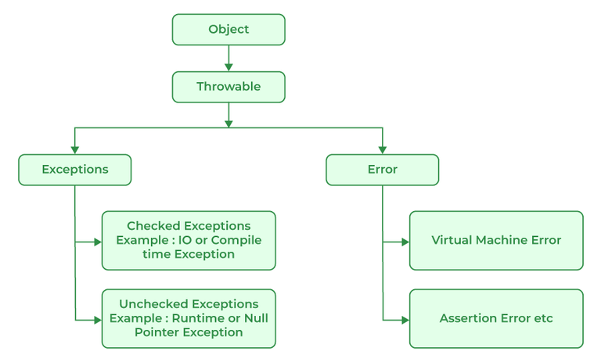
Exception Hierarchy

Slide 11
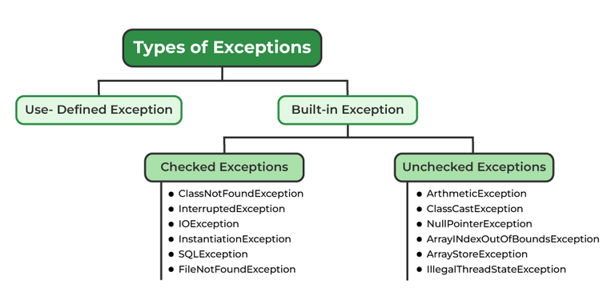
Types of Exceptions
Java defines several types of exceptions that relate to its various class libraries. Java also allows users to define their own exceptions.

Slide 12
Types of Exceptions
Exceptions can be categorized in two ways:
Built-in Exceptions
Checked Exception
Unchecked Exception
User-Defined Exceptions

Slide 13
Built-in Exceptions
Built-in exceptions are the exceptions that are available in Java libraries. These exceptions are suitable to explain certain error situations.
Checked Exceptions:
Checked exceptions are called compile-time exceptions because these exceptions are checked at compile-time by the compiler.

Slide 14
Built-in Exceptions
Unchecked Exceptions:
The unchecked exceptions are just opposite to the checked exceptions.
The compiler will not check these exceptions at compile time.
In simple words, if a program throws an unchecked exception, and even if we didn’t handle or declare it, the program would not give a compilation error.

Slide 15
User-Defined Exceptions:
Sometimes, the built-in exceptions in Java are not able to describe a certain situation. In such cases, users can also create exceptions, which are called ‘user-defined Exceptions’.

Slide 16
Java Exception Keywords
Java provides five keywords that are used to handle the exception.
try:
The "try" keyword is used to specify a block where we should place an exception code. It means we can't use try block alone. The try block must be followed by either catch or finally.

Slide 17
Java Exception Keywords
catch:
The "catch" block is used to handle the exception. It must be preceded by try block which means we can't use catch block alone. It can be followed by finally block later.
finally:
The "finally" block is used to execute the necessary code of the program. It is executed whether an exception is handled or not.

Slide 18
Java Exception Keywords
throw:
The "throw" keyword is used to throw an exception.
throws:
The "throws" keyword is used to declare exceptions. It specifies that there may occur an exception in the method. It doesn't throw an exception. It is always used with method signature.

Slide 19
Example
public class Main {
public static void main(String[] args) {
int[] myNumbers = {1,2,3};
System.out.println(myNumbers[10]); // error!
}
}
This will generate an error, because myNumbers[10] does not exist. The output will be something like this:
Exception in thread "main" java.lang.ArrayIndexOutOfBoundsException: 10 at Main.main(Main.java:4)

Slide 20
Example
If an error occurs, we can use try...catch to catch the error and execute some code to handle it:
public class Main {
public static void main(String[] args) {
try {
int[] myNumbers = { 1, 2,3};
System.out.println(myNumbers[10]);
} catch (Exception e) {
System.out.println("Something went wrong.");
}
}
}

Slide 21
Example
The output will be:
Something went wrong.
Finally :
The finally statement lets you execute code, after try...catch, regardless of the result:

Slide 22
Example
public class Main {
public static void main(String[] args) {
try {
int[] myNumbers = { 1, 2,3 };
System.out.println(myNumbers[10]);
} catch (Exception e) {
System.out.println("Something went wrong.");
} finally {
System.out.println("The 'try catch' is finished.");
}
}
}

Slide 23
Example
The output will be:
Something went wrong. The 'try catch' is finished.

Slide 24
The throw keyword
The throw statement allows you to create a custom error.
The throw statement is used together with an exception type.
There are many exception types available in Java: ArithmeticException, FileNotFoundException, ArrayIndexOutOfBoundsException, SecurityException, etc:

Slide 25
Example
Throw an exception if age is below 18 (print "Access denied"). If age is 18 or older, print "Access granted":
public class Main {
static void checkAge(int age) {
if (age < 18) {
throw new ArithmeticException("Access denied - You must be at least 18 years old.");
} else {
System.out.println("Access granted - You are old enough!");
}
}

Slide 26
Example
public static void main(String[] args) {
checkAge(15); // Set age to 15 (which is below 18...)
}
}
The output will be:
Exception in thread "main" java.lang.ArithmeticException: Access denied - You must be at least 18 years old. at Main.checkAge(Main.java:4) at Main.main(Main.java:12)

Slide 27
The throws keyword
Similarly, the throws keyword is used to declare the type of exceptions that might occur within the method. It is used in the method declaration.
import java.io.*;
class Main {
public static void findFile() throws IOException {
File newFile = new File("test.txt");
FileInputStream stream = new FileInputStream(newFile);
}

Slide 28
The throws keyword
public static void main(String[] args) {
try {
findFile();
} catch (IOException e) {
System.out.println(e);
}
}
}
Output:
java.io.FileNotFoundException: test.txt (The system cannot find the file specified)

Slide 29
The throws keyword
When we run this program, if the file test.txt does not exist, FileInputStream throws a FileNotFoundException which extends the IOException class.
The findFile() method specifies that an IOException can be thrown. The main() method calls this method and handles the exception if it is thrown.
If a method does not handle exceptions, the type of exceptions that may occur within it must be specified in the throws clause.

Slide 30
User-defined Exceptions
You can create your own exceptions in Java. Keep the following points in mind when writing your own exception classes −
All exceptions must be a child of Throwable.
If you want to write a checked exception that is automatically enforced by the Handle or Declare Rule, you need to extend the Exception class.
If you want to write a runtime exception, you need to extend the RuntimeException class.

Slide 31
User-defined Exceptions
We can define our own Exception class as below −
You just need to extend the predefined Exception class to create your own Exception.
These are considered to be checked exceptions.
The following InsufficientFundsException class is a user-defined exception that extends the Exception class, making it a checked exception.
An exception class is like any other class, containing useful fields and methods.
class InsufficientFundsException extends Exception {
}

Slide 32
User-defined Exceptions
// File Name InsufficientFundsException.java
import java.io.*;
public class InsufficientFundsException extends Exception {
private double amount;
public InsufficientFundsException(double amount) {
this.amount = amount;
}
public double getAmount() {
return amount;
}
}

Slide 33
User-defined Exceptions
To demonstrate using our user-defined exception, the following CheckingAccount class contains a withdraw() method that throws an InsufficientFundsException.

Slide 34
User-defined Exceptions
// File Name CheckingAccount.java
import java.io.*;
public class CheckingAccount {
private double balance;
private int number;
public CheckingAccount(int number) {
this.number = number;
}
public void deposit(double amount) {
balance += amount;
}

Slide 35
User-defined Exceptions
public void withdraw(double amount) throws InsufficientFundsException {
if (amount <= balance) {
balance -= amount;
} else {
double needs = amount - balance;
throw new InsufficientFundsException(needs);
}
}

Slide 36
User-defined Exceptions
public double getBalance() {
return balance;
}
public int getNumber() {
return number;
}
}

Slide 37
User-defined Exceptions
The following BankDemo program demonstrates invoking the deposit() and withdraw() methods of CheckingAccount.
// File Name BankDemo.java
public class BankDemo {
public static void main(String[] args) {
CheckingAccount c = new CheckingAccount(101);
System.out.println("Depositing $500...");
c.deposit(500.00);

Slide 38
User-defined Exceptions
try {
System.out.println("\nWithdrawing $100...");
c.withdraw(100.00);
System.out.println("\nWithdrawing $600...");
c.withdraw(600.00);
} catch (InsufficientFundsException e) {
System.out.println("Sorry, but you are short $" + e.getAmount());
e.printStackTrace();
}
}
}

Slide 39
User-defined Exceptions
Compile all the above three files and run BankDemo. This will produce the following result −
Output
Depositing $500...
Withdrawing $100...
Withdrawing $600...
Sorry, but you are short $200.0
InsufficientFundsException
at CheckingAccount.withdraw(CheckingAccount.java:25)
at BankDemo.main(BankDemo.java:13)

